Slide 1
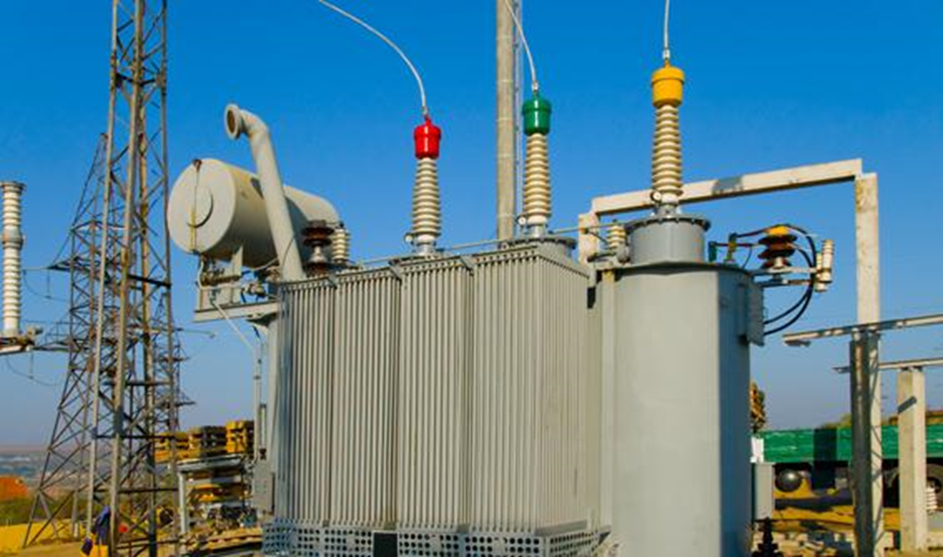
Reducing losses in power distribution through improved efficiency of distribution transformers Proposal to APEC EGEEC – March 2015
By Mayur Karmarkar and Pierre Cazelles
International Copper Association Asia

Slide 2
Distribution losses
Electrical equipment (for production, air conditioning, and illumination)
Transmission and distribution (electric power companies)
Low-Voltage Distribution (factories and buildings)
Power plant
Consumer side
100%
95%
95%
91%
5%
4%
Loss
Loss
Based on IEA data, transmission and distribution (T&D) losses in electricity networks in APEC economies vary from a low of 2.8% to a high of 15.6 % of final consumption.
About a third of T&D losses take place in distribution transformers (DTs).

Slide 3
DT losses in APEC economies
From APEC EWG 15/2012A: APEC Distribution Transformers Survey: Estimate of Energy Savings Potential from Increase in MEPS:
LBNL’s quantitative analysis shows that the cost-effective potential for distribution transformers in the APEC economies represents:
• 32 terawatt hours (TWh) of electricity savings in 2030, roughly equivalent to the output of eleven 500-MW power plants.
• 20 percent reduction over the 157 TWh electricity distribution losses projected in 2030
• 18 million tons (Mt) of annual carbon dioxide (CO2) emissions reductions by 2030, equivalent to 450,000 cars taken off the road.
• 135 Mt of cumulative emissions savings between 2016 and 2030
• 19 billion USD in cumulative consumer financial benefits

Slide 4
MEPS and EESL
The potential energy savings estimated by LBNL could be achieved through pro-active MEPS and EESL programs.
The EE standards used have a determining impact on the energy saving potential of such programs
IEC upcoming standard on EE for DTs describes 3 scenarios:
Load losses / no load losses
Efficiency at 50% load
Peak efficiency index

Slide 5
Measurement of EE in DT
Load factor
Time

Slide 6
Distribution Transformers EE Regulations
Economy | Regulation Type | Mandatory / Voluntary | Definition of performance
Australia | MEPS | Mandatory | Efficiency @ 50% Load
Canada | MEPS / Endorsement Label | Mandatory / Voluntary | Efficiency @ 50% Load
China | MEPS / Comparative label | Mandatory / Mandatory | Load & No Load Loss
EU | MEPS (Ecodesign)* | Mandatory | Load & No Load Loss
Japan | MEPS (Top Runner Program) | Mandatory | Efficiency @ 40% OR 50% Load
Korea | MEPS / Endorsement Label | Mandatory / Voluntary | Efficiency @ 50% Load
Mexico | MEPS / Endorsement Label | Mandatory/ Voluntary | Efficiency @ 80% Load
New Zealand | MEPS | Mandatory | Efficiency @ 50% Load
Peru | MEPS* | Mandatory | Load & No Load Loss
USA | MEPS | Mandatory | Efficiency @ 50% Load
Vietnam | MEPS | Mandatory | Efficiency @ 50% Load

Slide 7
Measurement of EE in DT
For practical reasons, many standards measure the energy efficiency of DT at 50% load (Ideal case), whereas actual losses in a DT are determined by:
No Load Loss + (Load Loss X Load Factor²)
These losses are not measured with standards using 50% load method

Slide 8
Impact of using 50% load to measure EE
(With reference to previous slide) Due to change in load curve shape & design options in DT losses:
ACTUAL energy consumption of DTs (and therefore losses) is HIGHER than the “best case” scenario (using the 50% load standard) by 24% (realistic case) to 73% (worst case)
The energy savings estimates of LBNL of 32 TWh (by 2030) in APEC economies should therefore be much higher by up to 23 TWh
This corresponds to an uncertainty about energy savings and actual energy consumption by 73%
In other words, using 50% load to test the EE of DTs:
does not allow to capture the actual losses of DTs
does not allow to correctly estimate energy savings potential
does not create avenues for appropriately and efficiently improve efficiency in DTs through technology drive

Slide 9
Rationale
The best way to estimate the ACTUAL energy consumption and energy efficiency of DTs is the load/no-load losses approach, as it best reflects the actual situation
EU and China have already adopted this method
Consultation with utilities:
Matches with existing procurement practices (procurement notices specify requirements in terms of load/no-load losses)
Higher flexibility of usage (irrespective of load curve)
Transformers are designed based on load/no-load losses (no impact on industry with adoption of load/no-load losses method, no impact on test protocol)
Advantage:
(much) better estimate of actual energy consumption of DTs and distribution losses
Push manufacturers to enhance design of DTs to increase EE at peak load conditions

Slide 10
Proposal objective
Long-term objective: APEC member economies reduce distribution losses through adoption of most appropriate method to regulate energy performance of DTs
Specific objectives:
Provide understanding of technology options and potential for further improvement of energy performance
Comparative analysis of efficiency @ 50% load vs. load/no-load losses and peak efficiency index to measure uncertainty in distribution loss estimates
Recommend most appropriate method; impact analysis

Slide 11
Proposed approach
Performance (EE) of DTs depends on design/components as well as load curve
Study technological trend while optimizing loss performance in distribution transformers and possible impact on each loss components
Study load curve changes due to liberalization of electricity markets, smart grids, energy storage, distributed generation etc.
The most appropriate method to measure EE (50% load, load/no-load losses) should depend on realistic load curve profiles and technology options
Relate above two studies and suggest the method to regulate energy performance in DTs to minimize uncertainty in energy saving benefit (from 50% EE to load/no-load losses standard)
Dissemination through international conference
Prepare White Paper for policy makers
International consultation with utilities and manufacturers

Slide 12
Methodology
Establish Steering Committee | With manufacturers and representatives from utilities; coordinated by ICA
Consultant (sub-contracted) conduct the studies | Consultation with Steering Committee ensured by ICA
Consultation with manufacturers, policy makers and utilities | During international conference, organized by ICA
Consultant helps prepare White Paper | Liaison with Steering Committee ensured by ICA
Endorsement of White Paper by EGEEC
Dissemination through international conference | Organized by ICA
White Paper published in international journals

Slide 13
Budget
Project duration: 2 years
Budget:
Consultant: 100K
Honorarium for Steering Committee members: 15K
Meetings of SC: 45K
International conferences (2): 100K
Total: 225K
APEC: 160K / ICA: 100K (for the international conferences)

Slide 14
Thank you
For more information, please contact:
Mayur Karmarkar,
mayur.karmarkar@copperalliance.asia
Pierre Cazelles,
Pierre.cazelles@copperalliance.asia

