Slide 1


Testing and Compliance
for Standards and Labelling in Thailand
Mr. Asawin Asawutmangkul
Senior Engineer
Bureau of Energy Efficiency Promotion
Department of Alternative Energy Development and Efficiency
Ministry of Energy, Thailand
Feb 27-28, 2012
39th Meeting of the APEC Expert Group on Energy Efficiency & Conservation
Sydney, Australia

Slide 2

Outline
Overview of S&L in Thailand
What are the major compliance issues faced by Thailand?
What would help Thailand to improve compliance rates?
What testing capacities exist within Thailand?
Challenges of harmonization of energy efficiency standards in ASEAN

Slide 3
1
Overview of S&L in Thailand

Slide 4
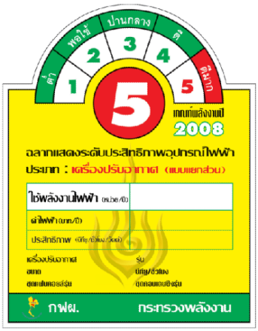


Framework of EES&L Measures
MEPS: Minimum Energy Performance Standard
HEPS: High Energy Performance Standard
Both voluntary and mandatory program
Collaboration between DEDE and TISI
Standards are set up by DEDE, but they are regulated by TISI.
Voluntary program
Collaboration between DEDE and EGAT
Standards are set up by DEDE, and labelling programs are responsible by DEDE and EGAT
4

Slide 5
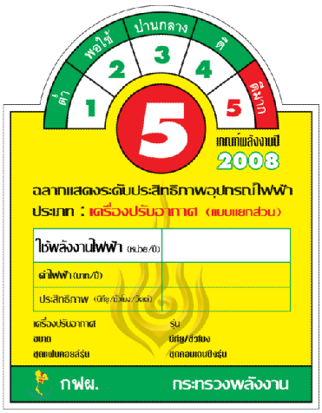
Labeling for Appliances
Energy Consumption (kWh/year)
Efficiency (BTU/hr/Watt)
EGAT : Electricity Generating Authority of Thailand
Ministry of Energy

Slide 6

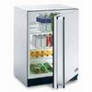
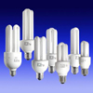
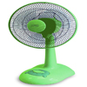
Energy labeling by EGAT
1) 1994 - Refrigerators
2) 1995 - Air conditioners
3) 1996 - Compact fluorescent lamps
4) 1998 - Low loss magnetic ballasts
5) 2001 - Electric fans
6) 2003 - Electric rice cookers
7) 2003 - Lighting fixtures
8) 2009 - T5 fluorescent lamps
9) 2009 - T5 electronic ballasts
10) 2009 - Oscillating fans
11) 2010 - Standby power for televisions
12) 2010 - Standby power for computer monitors
13) 2010 - T5 luminaires
14) 2011 - Electric pots

Slide 7

Labeling for Non-Appliances
Number 5 is shown the highest efficiency mark
Authority
Energy Saving
High Efficiency
Name of Product
Percentage of Efficiency Value
DEDE : Department of Alternative Energy Development and Efficiency

Slide 8
Energy labeling by DEDE
4 Products From 2007 to Present
LPG Stoves
VSD
Glazing
Insulator
2 new coming products
Gasoline engines
Diesel engines

Slide 9
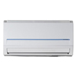
Ministerial Regulations (HEPS)
Air conditioners
Refrigerators
AC electric fans
Chillers
Glazing
Electric water heaters
Rice cookers
Electric pots
Note: 8 Ministerial Regulations have been effective since April 8, 2009.

Slide 10
The product certification schemes of TISI consist of 2 types with different certification marks.
Thai Industrial Standards Institute (TISI) www.tisi.go.th

Slide 11

2
What are the major compliance issues faced by Thailand?

Slide 12
What are the major compliance issues faced by Thailand?
MEPS cannot be mandated in the early stage.
Labelling for HEPS is a voluntary program, so only highest efficiency number is requested from manufacturers.
DEDE has the Energy Conservation Promotion Act, but mandatory program for EE label is not identified in the Act.

Slide 13
3
What would help Thailand to improve compliance rates?

Slide 14
What would help Thailand to improve compliance rates?
Ministry of Energy has set “20 Years Energy Conservation Plan between 2011 and 2030”. S&L is one of the master keys. Government has targeted to mandate EE label. It means that every energy efficient rate must be shown in the future.
To mandate EE label, Ministry of Energy needs to collaborate with another organisation i.e. Office of The Consumer Protection Board.

Slide 15
4
What testing capacities exist within Thailand?

Slide 16
What testing capacities exist within Thailand?
Energy Laboratory Network Project has been operating by DEDE since 2007.
28 EE laboratories are members of DEDE cover the testing of air conditioning, lighting, vehicles and etc.

Slide 17
Accreditation requirement according to laboratory type
Type | Laboratory Organization | Accreditation Requirement
1 | Government Organization | TIS – 17025 or TISI – R – TL - 01
2 | Private / Government Organizations | TIS - 17025
Note: TIS – 17025 is equivalent to ISO/IEC 17025

Slide 18
Problems and Barriers
Incentives: cost of testing is not very attractive.
Investment cost: a high investment cost for some instrument will be longer payback period time.
Teaching purposes: especially the laboratories that belong to institution or university are used for teaching, research purposes, rather than testing services.
Personal: a limitation of person to deal with ISO 17025 and also quite a long time taken for the accreditation.
Etc.

Slide 19
5
Challenges of harmonization of energy efficiency standards in ASEAN

Slide 20
Major Steps in Harmonization Process
Step 1: Consultation with stakeholders, finalization of action plan > Kick-off meeting 17-18 Jan 2012 @ Jakarta, Indonesia
Step 2: Harmonize testing methods
Step 3: Harmonize EE standards
Step 4: Recommend MEPS and HEPS and develop roadmap
Step 5: Capacity building for testing laboratories and AC manufacturers
Step 6: Consumer awareness

Slide 21

Thank you…
Bureau of Energy Efficiency Promotion
Department of Alternative Energy Development and Efficiency
Ministry of Energy, Thailand
www.dede.go.th

